Slide 1
Shaydel engel

Slide 2
Methods: Drugs
ANA-12 – TrkB antagonist
ANA-DIO-ChR2- adeno-associated virus vector expressing channelrhodopsin-2 fused with eYFP from a double loxP-flanked (DIO) Cre recombinase–dependent locus
PRV-Cre -- pseudorabies virus vector expressing Cre recombinase

Slide 3
Methods: Experimental subjects
C57BL/6J mice
Th^{cre} mice
BDNF^{loxP/loxP} mice
B6129PF2/J mice (control for BDNF^{loxP/loxP} mice)

Slide 4
Methods: transfection and infusions
0.5 μl AAV-DIO-ChR2-eYFP or AAV-DIO-eYFP infused bilaterally into VTA
0.5 μl PRV-Cre or AAV2/5-DIO-ChR2-eYFP (AAV2) infused into Nac
Optic fibers implanted into VTA
Infusion cannula (26-gauge) implanted bilaterally into Nac
0.3 μl bilateral infusion of ANA-12, alpha-helical CRF, CRF, or vehicle
One hour before social interaction test

Slide 5
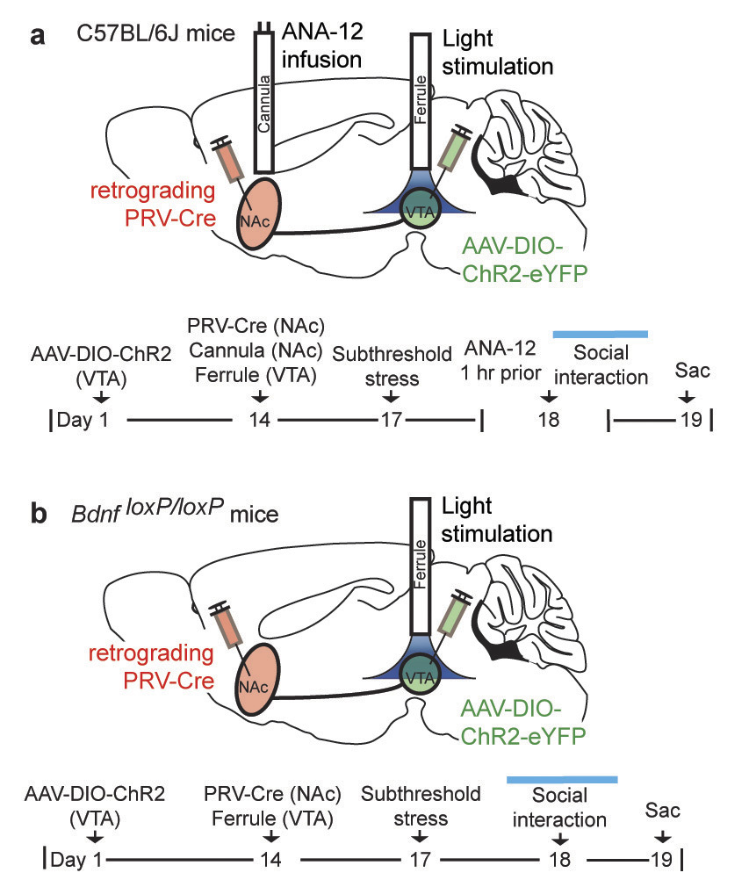
Notes:
Schematic and timeline of VTA-NAc neurons with cannula implantation into NAc for infusion of TrkB inhibitor, ANA-12, 1 h prior to behavior with stimulation.
(b) Schematic and timeline showing targeting of VTA-NAc cells in Bdnf^{loxP/loxP} and controls.

Slide 6
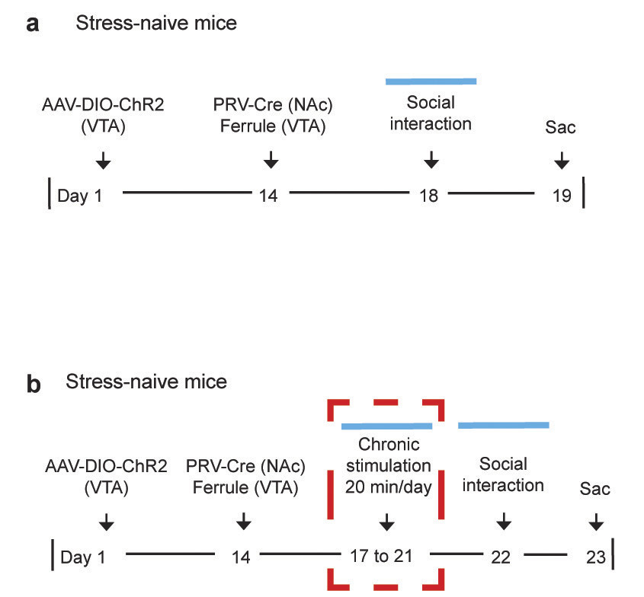
Walsh et al 2014
Notes:
Experimental timeline of stress-naïve mice with optical stimulation during social interaction.
(b) Timeline of stress-naïve mice with five days of repeated optical stimulation (20 min/day)

Slide 7
Walsh et al 2014
Notes:
Schematic adapted from Allen Brain Atlas illustrating validation of NAc injection cite (scale 50 μm). Accurate injection sites were confirmed in all animals.
(b) Schematic adapted from the Allen Brain Atlas showing VTA and confocal images showing co-expression of AAV-DIO-ChR2-eYFP and TH-positive cells in VTA that specifically project to NAc (scale 50 μm).

Slide 8
Walsh et al 2014
Notes:
Schematic of ChR2 into NAc and ferrule implantation into VTA of Th^{cre} mice and timeline.
(b) Confocal image showing co-expression of AAV2/5-DIO-ChR2-eYFP and TH-positive cells in VTA to NAc cells of Th^{cre} (scale 25 μm).
(c) Phasic light stimulation induced spiking in VTA-NAc DA neurons expressing AAV2/5.

Slide 9
summary
AAV2 expressing cells colocalize with TH cells in both NAc and VTA
Phasic stimulation increased firing of VTA-NAc

Slide 10
Methods: Social Interaction
Berton et al 2006
Notes:
B) Videotracking data from control and defeated mice in the absence and presence of a social target. (
C) (Top) A social target increased the time spent in the interaction zone by control mice (n 0 18 mice), an effect suppressed after social defeat (n 0 36 mice), which had no effect on total locomotion (bottom). [Analysis of variance (ANOVA): Target 􏰀 defeat interaction F (2,150) 0 7.26, P G 0.001. Least-square difference (LSD) post-hoc test: þþþP G 0.001 versus control ‘‘no target,’’ ***P G 0.001 versus ‘‘target.’’]

Slide 11
Methods: Subthreshold stressor
Occurs twice in 24hr period with 15min in between
5min with aggressor
15min in rest home cage

Slide 12
Walsh et al 2014
Notes:
(a) Schematic of PRV-Cre infused into NAc, AAV-DIO-ChR2-eYFP infused into VTA, and ferrule implantation into VTA with experimental timeline below.
(b) Representative image of real-time tracing of animals during the social interaction test with optical stimulation. Left panel shows an eYFP control animal and right panel shows an animal that received phasic stimulation with ChR2.

Slide 13
TH cre mice
Stress naïve mice
Stress naïve mice after 5d of 20min stimulation
Walsh et al 2014
Notes:
Duration of social interaction during tonic and phasic stimulation of VTA-NAc cells (F_{2,20} = 4.56, *P = 0.0231, n = 7,7,9 mice). eYFP and ChR2 represent control and AAV-DIO-ChR2-eYFP vectors, respectively. 'No target' and 'target' denote absence and presence, respectively, of a social target (CD1 mouse) during behavior. Blue bars represent activation with light during social interaction.
(b) NAc BDNF amounts (top) and western blot gels (bottom) 24 h after stimulation (F_{2,19} = 14.55, **P = 0.0058,n = 7,7,8 mice).
(c) Durations of social interaction of Th^{cre} mice during tonic and phasic stimulation of VTA-NAc DA neurons (F_{2,15} = 19.35, ***P < 0.0001, n = 6,6,6 mice).
(d) NAc BDNF amounts in Th^{cre}mice 24 h after stimulation (F_{2,15} = 3.69, *P = 0.0497, n = 6,6,6 mice).
(e) Duration of social interaction of stress-naive mice during tonic or phasic stimulation (F_{2,18} = 1.12, P = 0.3473, n = 6,7,8 animals).
(f) NAc BDNF amounts in stress-naive mice 24 h after stimulation (F_{2,18} = 0.03, P = 0.9730, n = 6,7,8 mice).
(g) Duration of social interaction of stress-naive mice after 5 d of 20 min/day repeated stimulation (F_{2,24} = 0.30, P = 0.7437, n = 9,10,8 mice). (h) NAc BDNF amounts 24 h after social interaction (F_{2,21} = 0.38, P = 0.6883, n = 8,8,8 mice). Full-length blots are available in Supplementary Figure 10. All bars represent mean ± s.e.m. P values were calculated using one-way analysis of variance (ANOVA).

Slide 14
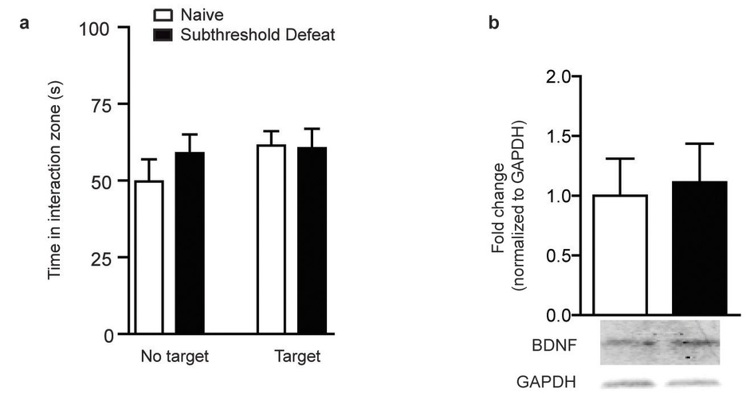
Walsh et al 2014
Notes:
Social interaction times of stress-naïve and subthreshold defeated animals (unpaired t-test, t₈ = 0.125, P = 0.9004, n = 5,5 mice/group).
(b) Quantification of NAc BDNF levels following subthreshold social (unpaired t-test, t₈ = 0.253, P = 0.8069; n = 5,5 mice/group).

Slide 15
summary
Phasic stimulation, but not tonic, decreases time spent in interaction zone
Similar to effects of social defeat
Increases BDNF amount
Subthreshold defeat does not produce these results

Slide 16
Walsh et al 2014
Notes:
Figure 2 BDNF is necessary for the optogenetically induced susceptible phenotype. (
Duration of social interaction of mice that received intra-NAc infusions of TrkB inhibitor ANA-12 with phasic stimulation, as in Figure 1a (F2,23 = 5.59, **P = 0.0105, n = 6,10,10 mice). (
b) NAc BDNF amounts (top) and western blot gels (bottom) after infusions of ANA-12 and phasic stimulation (F2,22 = 16.18, **P = 0.0204, n = 8,9,8 mice). P values were calculated using one-way analysis of variance (ANOVA) (a,b).
Duration of social interaction during phasic stimulation of BdnfloxP/loxP compared to controls (unpaired t-test, t11 = 2.9, **P = 0.0154, n = 6,7 mice).
NAc BDNF amounts (top) and western blot gels (bottom) 24 h after stimulation (unpaired t-test, t9 = 4.78, **P = 0.0010, n = 5,6 mice). Bars in a–c represent mean ± s.e.m. In d, center line shows the median; box limits indicate s.e.m.; whiskers indicate minimum and maximum values.

Slide 17
Walsh et al 2014
Notes:
Figure 3 CRF is required for phasic firing induced increase in the NAc BDNF in the context of stress.
Duration of social interaction of stressed mice with infusion of intra-NAc CRF receptor antagonist (alpha-helical CRF) or vehicle 1 h before behavior with phasic stimulation of VTA-NAc neurons, as in Figure 1a (F2,21 = 3.99, *P = 0.0348, n = 6,8,9 mice).
(b) NAc BDNF amounts (top) and western blot gels (bottom) 24 h after stimulation (F2,18 = 4.66, *P = 0.0234, n = 6,7,8 mice).
(c) Duration of social interaction of stress-naive mice that received intra-NAc CRF infusions or vehicle 1 h before behavior and phasic stimulation (F2,23 = 0.58, P = 0.5674, n = 8,9,9 mice).
(d) NAc BDNF amounts (top) and western blot gels (bottom) 24 h after stimulation (F2,19 = 5.88, **P = 0.0103, n = 6,8,8 mice).
(e) Duration of social interaction of stress- and stimulation-naive mice that received intra-NAc CRF or vehicle infusions 1 h before behavior and phasic stimulation (F5,12 = 0.082, P = 0.9221, n = 5,5,5 mice).
(f) NAc BDNF amounts 24 h after stimulation (F2,12 = 0.186, P = 0.8329, n = 5,5,5 mice). All bars represent mean ± s.e.m. P values were calculated using one-way analysis of variance (ANOVA).

Slide 18
Lemos et al 2013
Notes:
Figure 2 | CRF increases dopamine release in the nucleus accumbens through coactivation of CRFR1 and CRFR2.
a, Representative dopamine release evoked by electrical stimulation (dashed lines) before (left) and after (right) application of 100 nM CRF (mean 6 s.e.m. for 5 consecutive stimulations, top) and corresponding two-dimensional plots depicting changes in faradaic current (pseudocolour) with time as the abscissa and applied potential as the ordinate (bottom).
b, Concentration response to CRF, n 5 11– 18.
c, Effect of antagonists for CRFR1 (antalarmin, 1000 nM) or CRFR2 (anti- sauvagine 30 (ASVG 30), 250 nM), n 5 18–20.
d, CRF in mice lacking the gene encoding the CRFR1 (left) or CRFR2 (right) receptors, n 5 7–13. e–g, Effect of the CRFR1 agonist, stressin 1, n 5 9–15
(e), the CRFR2 agonist, urocortin 3 (100 or 300 nM), n 5 5–8
(f) or their co-application, n 5 8–15
(g). Error bars, s.e.m. DA, dopamine; NS, not significant (with P . 0.05); *P , 0.05;
**P , 0.01 versus vehicle.

Slide 19
Lemos et al 2013
Notes:
6-OHDA
Alpha-helical CRF- blocks CRF1 and CRF2
Figure 3 | CRF in the nucleus accumbens promotes appetitive behaviour.
a, Mean difference in times spent in the CRF-paired chamber compared to the vehicle-paired chamber before and after conditioning (top panel; n 5 7 ) and representative post-conditioning activity trace (bottom panel).
b, Place preference (time in CRF-paired chamber minus the time spent in the vehicle- paired chamber post conditioning) for intra-nucleus accumbens injections of 500 ng CRF bilateral, 500 ng unilateral or 5 ng bilateral (left panel; n 5 7–10). Place preference for 500 ng CRF (unilateral) in sham or 6-OHDA-treated mice (right; n 5 10).
c, Time spent in the centre of an open field before and during presentation of a novel object (placed in the centre of the field) after bilateral intra-accumbens infusion of the CRF-receptor antagonist a-helical CRF
(500 ng) or its vehicle (n 5 10). Error bars, s.e.m. NS, P . 0.05; *P , 0.05; **P , 0.01; ***P , 0.001; 1P , 0.05 for interaction.

Slide 20
Lemos et al 2013
Notes:
Figure 4 | Stress exposure abolishes the CRF-mediated increase in evoked dopamine release and subsequent appetitive behaviours.
a, Effect of CRF on dopamine release in naive mice (blue) and after swim stress (red) (left panel; n 5 8–18), and in animals that were pretreated with the glucocorticoid- receptor antagonist, RU486 (30 mg kg21, intraperitoneal) or its vehicle before stress (right panel; n 5 6–10).
b, Mean place preferences for intra-accumbens CRF in naive (blue) and stress-exposed mice (red) (left panel; n 5 6–8) and representative activity traces (right).
c, Difference in the increased centre time during presentation of a novel object between vehicle and CRF-receptor antagonism in naive (blue) animals and in animals 7 days post stress (red)
(n 5 9–10). Error bars, s.e.m. NS, P . 0.05, *P , 0.05, **P , 0.01; 1P , 0.05; 11P , 0.01 for interaction.

Slide 21
Summary
CRF increases dopamine in nucleus accumbens
Mediated by both CRF₁ and CRF₂
CRF₁ or CRF₂ alone does not produce effect
Blocking CRF decreases novel object
CRF infusion in stress naïve animals has appetitive effects
CRF infusion in previously stressed animals has aversive effect

Slide 22
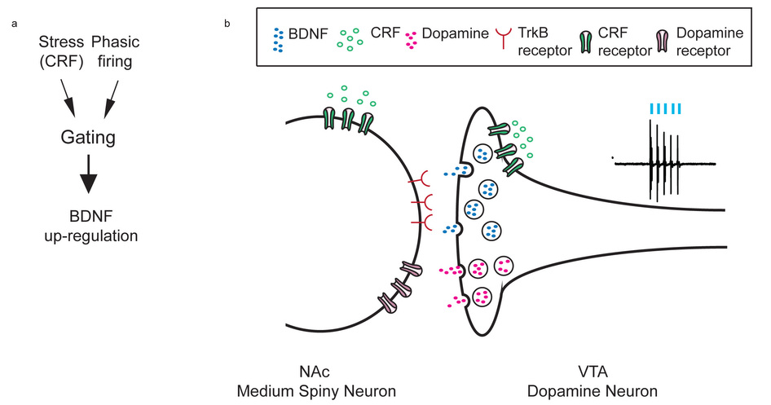
Walsh et al 2014
Notes:
(a) Schematic showing that stress gates the up-regulation of BDNF signaling in NAc by working together with phasic firing of VTA DA neurons that project to NAc as well as CRF actions in NAc, which may be both pre- and postsynaptic. (b) Schematic illustrating proposed interactions of BDNF and CRF in promoting stress susceptibility. Our data suggest that stress-induced CRF signaling in NAc activates its receptors located presynaptically on terminals of VTA DA neurons and works together with arriving phasic spikes from these DA neurons to release BDNF. BDNF then activates TrkB receptors located on NAc medium spiny neurons to promote susceptibility. Direct postsynaptic actions of CRF on these medium spiny neurons might also contribute to susceptibility.

